Slide 1
COMPANY DATA LEVEL ANALYSE
NAME: kowshik.s
REGISTER NO: 312207301
DEPARTMENT: COMMERCE
COLLEGE: CKNC

Slide 2
COMPANY DATA LEVEL ANALYSIS
BY USING MICRO SOFT EXCEL

Slide 3
AGENDA
PROBLEM OVERVIEW
SOCIAL LEVEL
ECONOMIC LEVEL
RESULT
CONCLUSION

Slide 4
PROJECT OVERVIEW
Our project aims to analyse the companies rating levels.
We seek accurately the turnover of the company.
The excel will expose the overall performance of the company.

Slide 5
PROBLEM STATEMENT
To analyse the company ratings level of the company all over the world. To find the profit trend analyse revenue and cost department performance seasonality and external factors using microsoft excel’s pie chart, flow chart, bar diagram and pivot table

Slide 6
SOCIAL LEVEL
The social level of companies refers to their impact, influence, and reputation within society. Here are some ways to categorize companies based on their social level:
Social Responsibility: - Low: Companies with poor track records on environmental, social, and governance (ESG) issues. - Medium: Companies with some ESG initiatives, but room for improvement. - High: Companies recognized for their strong commitment to ESG and social responsibility.

Slide 7
ECONOMIC LEVEL
Companies can be classified into different economic levels based on their size, revenue, and market impact. Here are some common economic levels of companies:
Micro-enterprises: Fewer than 10 employees, less than $1 million in revenue
2. Small businesses: 10-99 employees, $1-50 million in revenue
3. Medium-sized enterprises (SMEs): 100-499 employees, $50-500 million in revenue

Slide 8
Company rating analysis
Company rating analysis involves evaluating a company's performance and reputation based on various factors such as financial health, customer satisfaction, employee reviews, and market position. This analysis can help investors, customers, and employees make informed decisions.

Slide 9
Some common factors considered in company rating analysis include
Employee reviews and ratings (e.g., from websites like Glassdoor, Indeed)
Market position and competitiveness
Product or service quality
Leadership and management team
Corporate social responsibility and sustainability
Industry trends and outlook

Slide 10
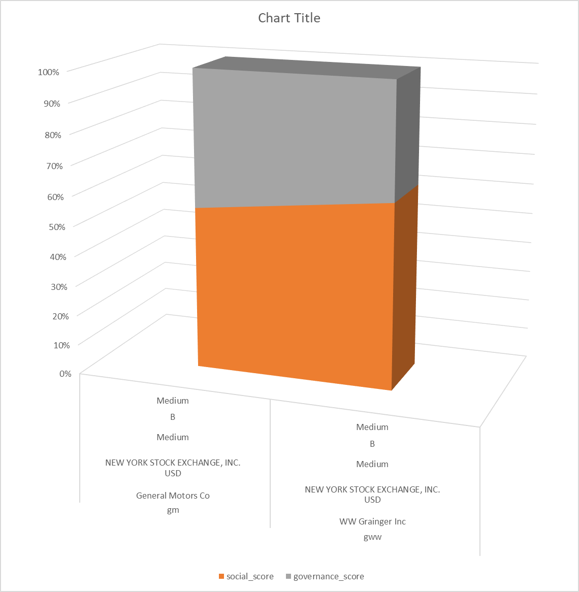
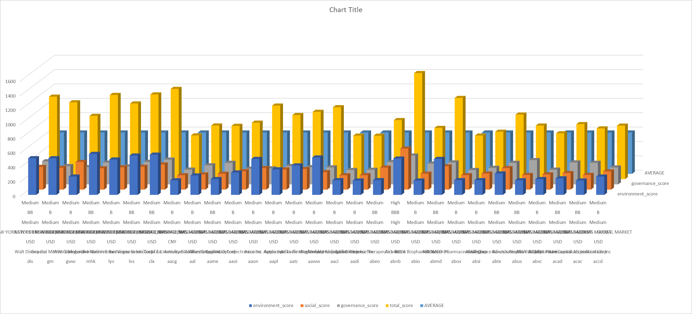
RESULT

Slide 11
CONCLUSION
By evaluating companies through both econmic and social lenses, we can gain a more comprehensive understanding of their overall impact and potential for long-term success.

Slide 12
THANK YOU!

